Slide 1
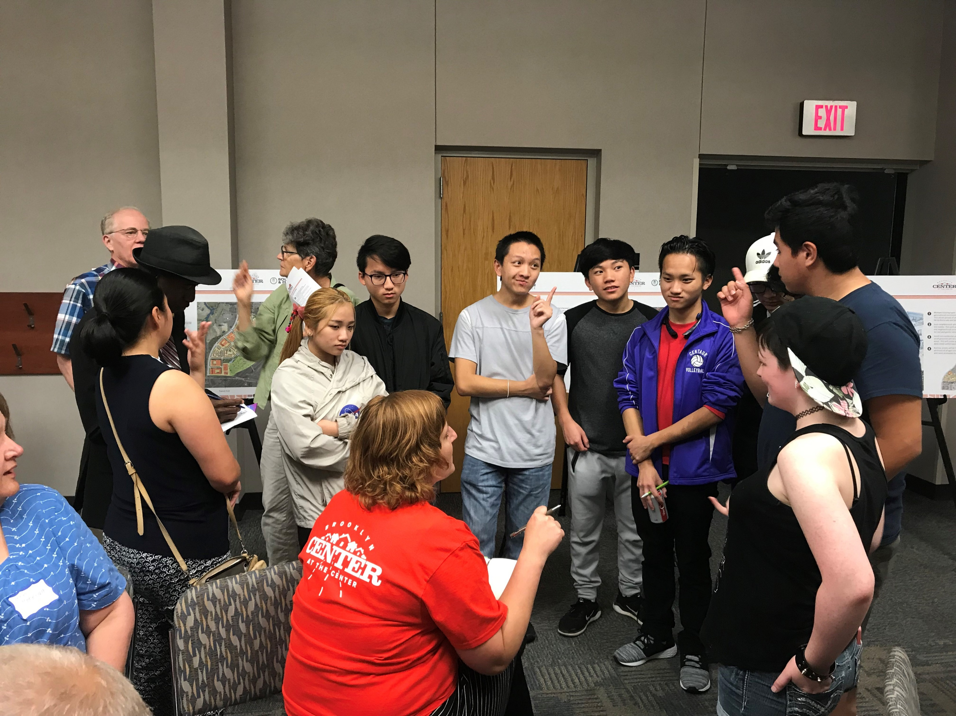
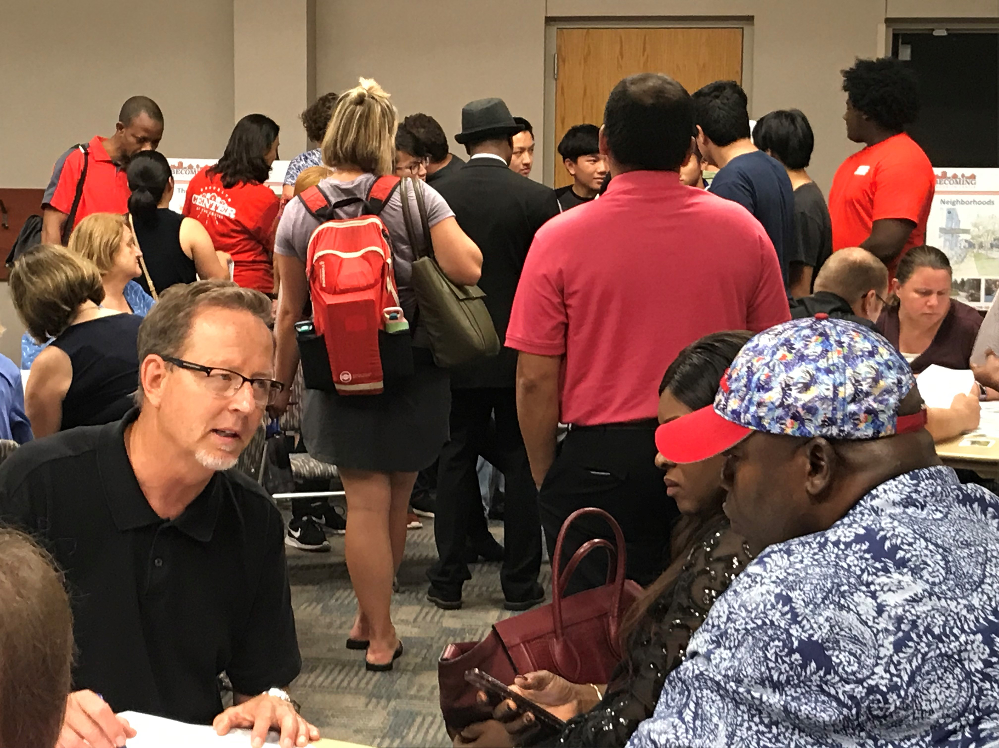
Recent Engagement
Events
Second Saturday Market - 9/14
Open House - 9/19
CEAP Farm Fresh Fest - 9/20
Community Band & BBQ - 9/21
Selected themes
Variety of housing types needed
Attractive public places and amenities
Shopping and entertainment options
Community pride and sense of ownership
Activities for children and youth

Slide 2
Master Planning Steps
Set goals and values
Establish framework
Develop scenarios
Adopt and implement
Review and update

Slide 3
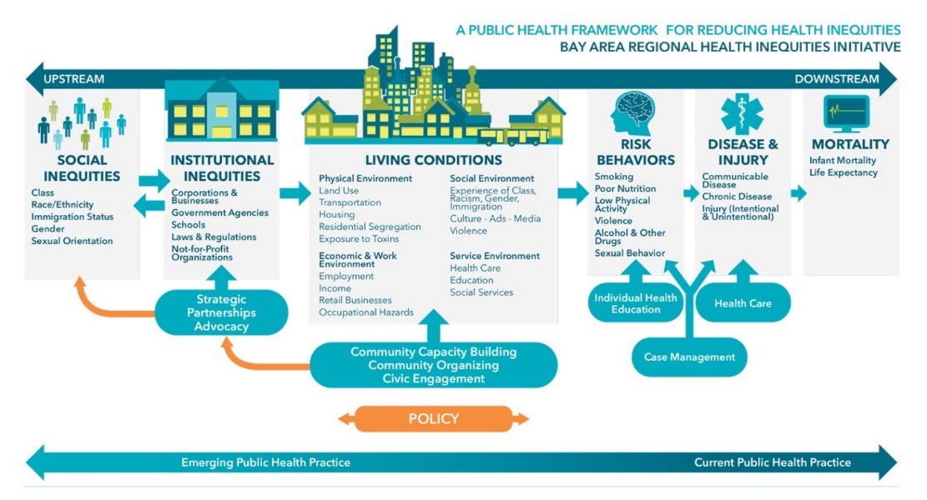
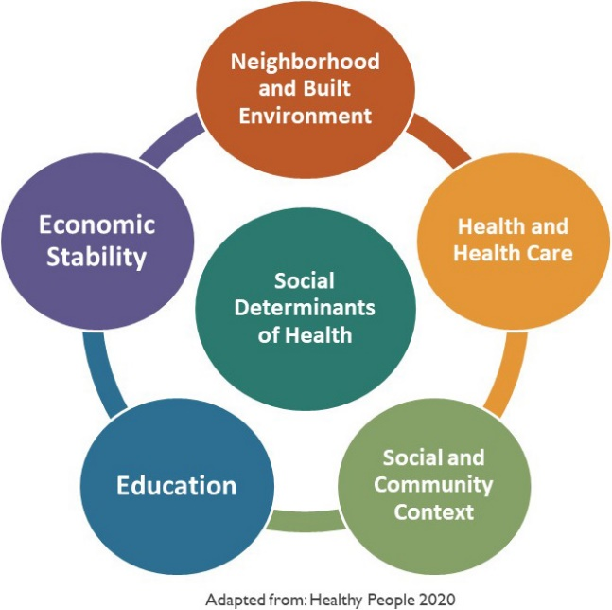
Holistic Approach to Community Impact

Slide 4
Master Planning Process
Phase | Technical Analysis | Engagement Questions | Outcomes
Phase 1: Development Scenario Drafting Summer 2019 | Initial site assessment including context Market conditions review | What elements should be included? What are the top priorities for improvements to the site? | Initial development concepts drafted. Identification of potential community benefits.
Phase 2: Development Scenario Review and Impact Assessment Fall 2019 | Equitable development toolkit Housing assessment Financial feasibility Environmental impact assessment | What are the biggest potential outcomes (positive and negative)? Who will be most impacted, and how can that be addressed? | Identification of benefits and costs, including mitigation Revisions to scenarios and initial plan draft
Phase 3: Plan Review, Approval, Early Implementation Winter 2020 (and beyond)` | Development concepts – master plan and phase 1 Mitigation plan Agreement on community benefits | Does the resulting plan align with community goals and values? How should the plan be implemented? What does the first phase of development look like? | Revised master plan Approach for mitigating impacts and ensuring community benefits Concepts for phase 1 implementation

Slide 5
Phase 1 Engagement (Spring/Summer 2019)
Questions
What elements should be included?
Outreach
LISC workshops and public open house
Outcomes
Elements included in the draft plan, including potential benefits
What are the top priorities for improvements to the site?
Pop up events and online survey questions
Values and goals for master planning process

Slide 6
Phase 2 Engagement (Fall 2019)
Questions
What are the biggest potential outcomes (positive and negative)?
Outreach
Partner outreach through working committee
Outcomes
Identification of benefits and costs, including mitigation
Who will be most impacted, and how can that be addressed?
Revisions to scenarios and initial plan draft
City-led focused discussions in community

Slide 7
Phase 3 Engagement (Winter 2020)
Questions
Does the resulting plan align with community goals and values?
Outreach
Other supplementary engagement, to be determined
Outcomes
Revised master plan, including implementation framework
How should the plan be implemented, particularly in the short term?
Formal review processes for each approval step
Approach for mitigating impacts and ensuring community benefits

Slide 8
For today
What are the right tools and strategies for engaging now?
What information and resources will be helpful when doing engagement?
How do we foster trust and support for the result?

